Slide 1

Research Project
Jaykishan & Minh

Slide 2
Why Is Rust?
Rust is a modern systems programming language developed by the Mozilla Corporation. It is intended to be a language for highly concurrent and highly secure systems. It compiles to native code; hence, it is blazingly fast like C and C++. It also is a multi-paradigm with being designed general-purpose programming language for without performance penalties, and concurrency safety.
Friendly and welcoming developer community
Quickly developing ecosystem of library.
Called a systems programming language and plus, high-level features such as functional programming offers mechanisms for low-level memory management.
Rust can be used both in front-end and back-end web.

Slide 3
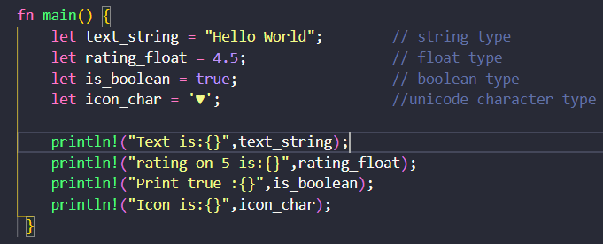
Data Types
Integer
Float
Booleans
Characters

Slide 4
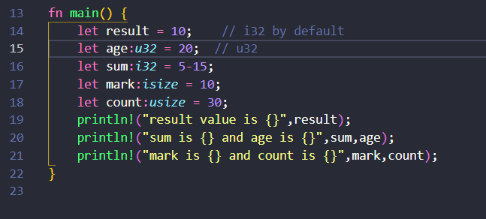
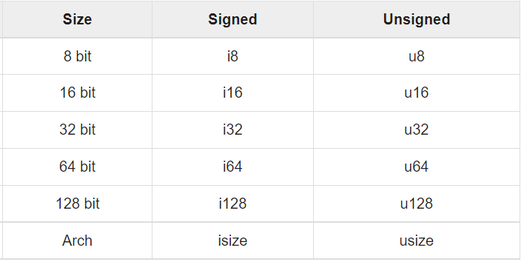
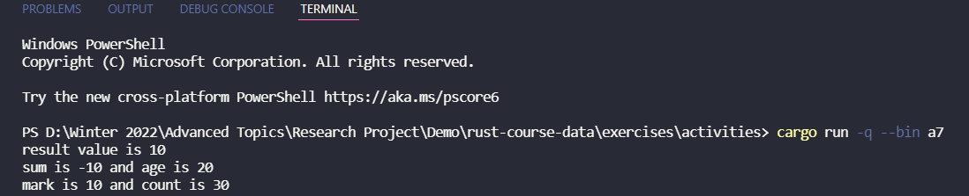
Integer
Signed
Store both negative and positive values
It is set by default
Unsigned
Only store positive values
Have to be declared

Slide 5
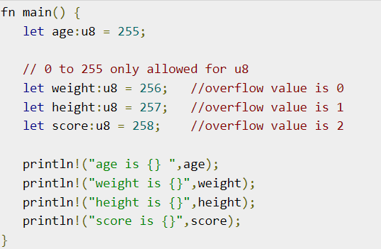
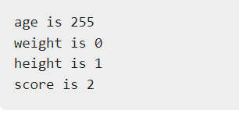
This size of arch will be taken from the architecture of the machine
If it is a x86 machine, the size of arch will be 32 bits
Otherwise, it will be 64 bits on x64 machine
Overflow will happen when a value assigned to an integer variable when exceeding its declaration

Slide 6
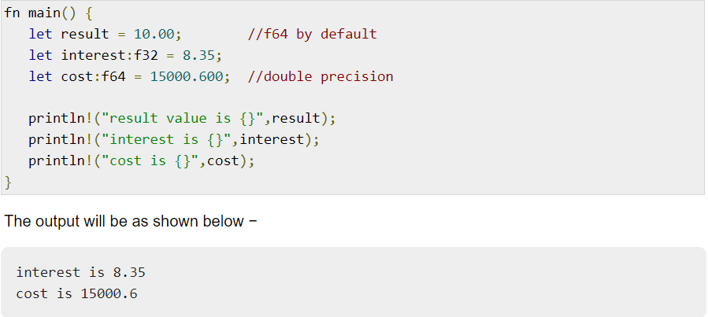
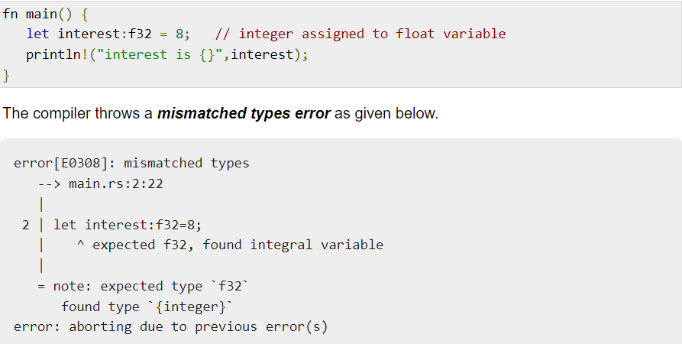
Float
There are two kinds of float type f32 & f64 being set by default
Type casting

Slide 7
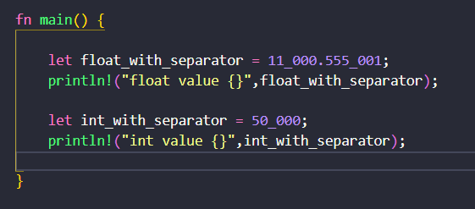
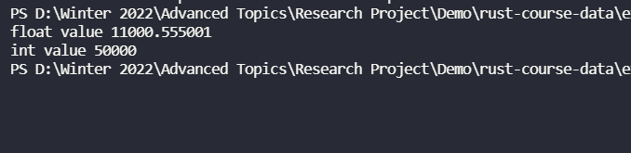
Number Separator
In order to make it easy readability with large numbers. Using visual separator underscore (_)

Slide 8
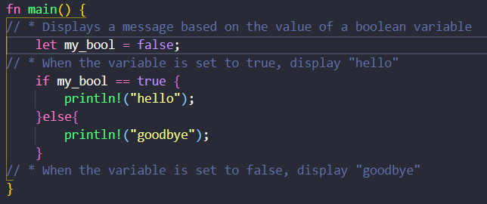
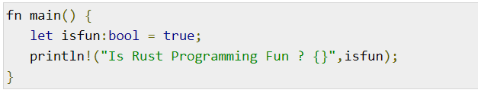
Boolean
Boolean type has two values true or false, it can be optional to either declare or not.

Slide 9
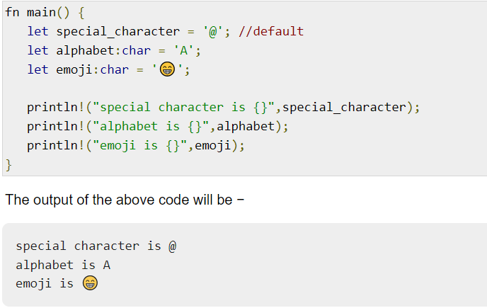
Character
Character type in Rust support numbers, alphabets, Unicode and special character like emoji
Unicode Scalar Values: range from U+0000 to U+D7FF and U+E000 to U+10FFFF

Slide 10
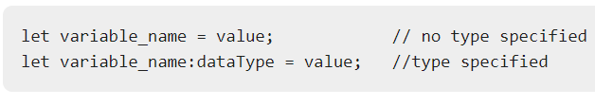
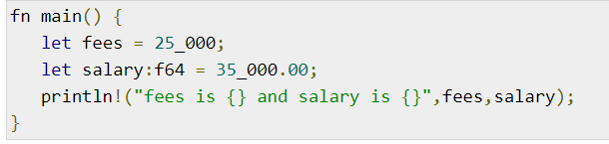
Variables
Rules for declaration in Rust:
Underscoring between character of letters, digits, and the underscore.
Must begin with either a letter or an underscore.
Upper and lowercase letters are distinct Rust is case-sensitive
By default, immutable is set at a read-only. By contrast, mutable (mut) allows to change to other values

Slide 11
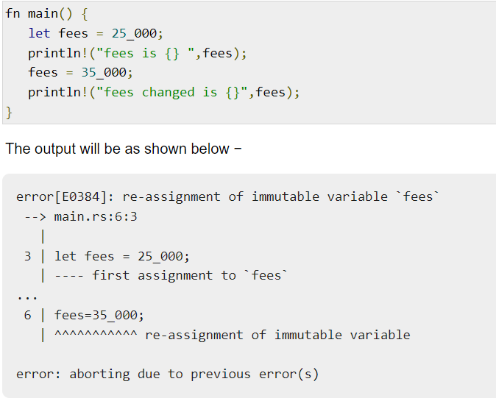
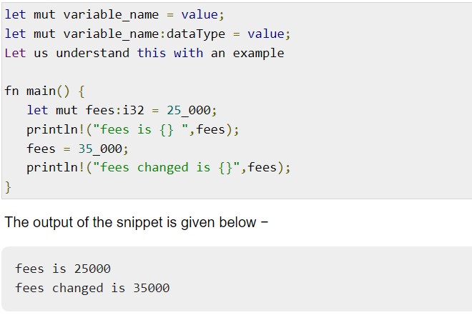
Immutable (without keyword) vs Mutable (with keyword mut)

Slide 12
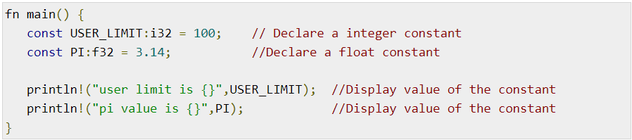
Constant
The keyword let declared is not a constant
To make a constant, capitalizing all characters is usually being used with keyword const.

Slide 13
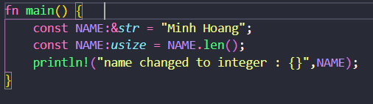
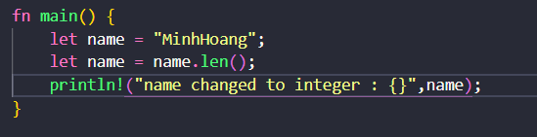
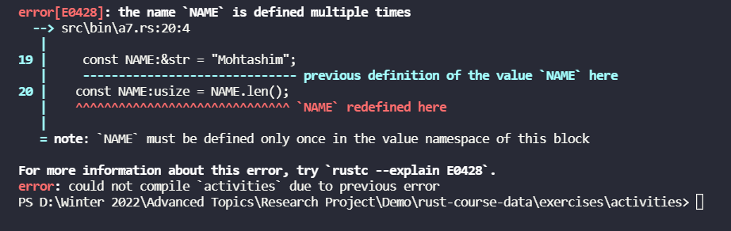
Constant vs Variables
Output:
Output:

Slide 14
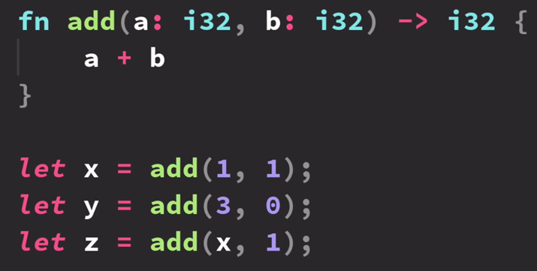
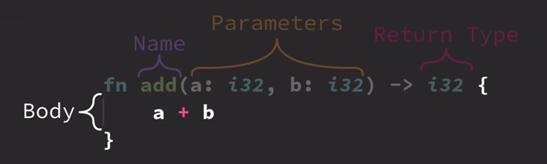
Functions
A way to encapsulate program functionality
Optionally accept data
Optionally return data
Utilized for code organization and makes it easier to read.
Create function in rust:

Slide 15
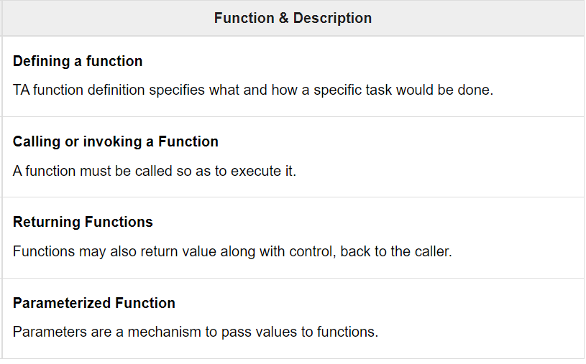
Categorized Functions
Defining Function:
=> fn fn_name(){//code…}
Invoking Function:
=> fn main(){ fn_name();}
Returning function:
=> fn fn_ame() -> return_data_type {//code… return value;}
Parameterized function:
=> fn fn_name (val1,val2) {//code}

Slide 16
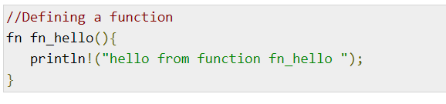
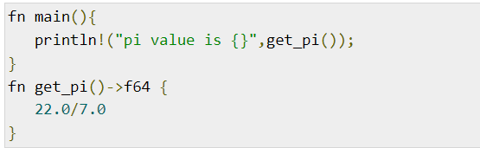
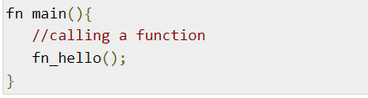
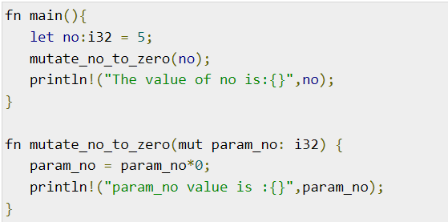
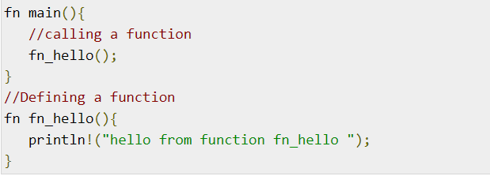
Defining Function
Returning Function
Invoking Function
Parameterized Function

Slide 17
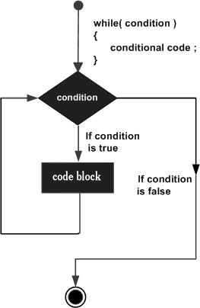
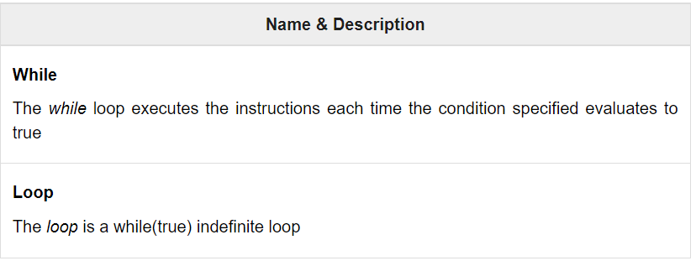
Looping
A loop in programming languages does the same purpose is executed repeatedly.
In Rust, it provides 2 types of loops definite and indefinite
Definite loop: for
Indefinite loop: while, looping

Slide 18
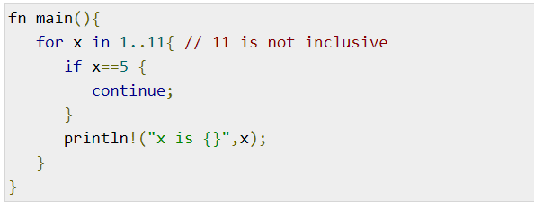
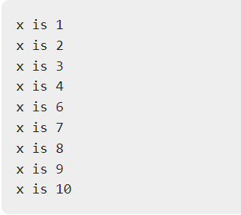
FOR STATEMENT
Definite loop makes the number of iterations of which is definite or fixed as for loop.
It would be executed the code block to iterate over set values like array

Slide 19
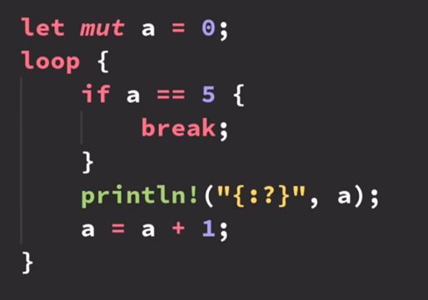
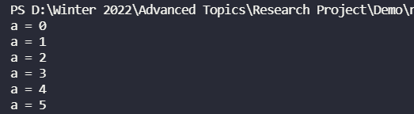
LOOP STATEMENT
Output:

Slide 20
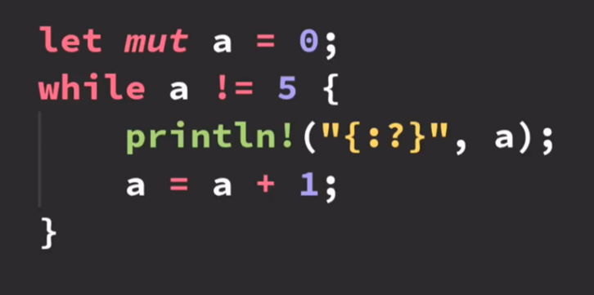
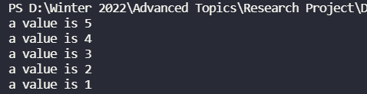
WHILE STATEMENT
Output:

Slide 21
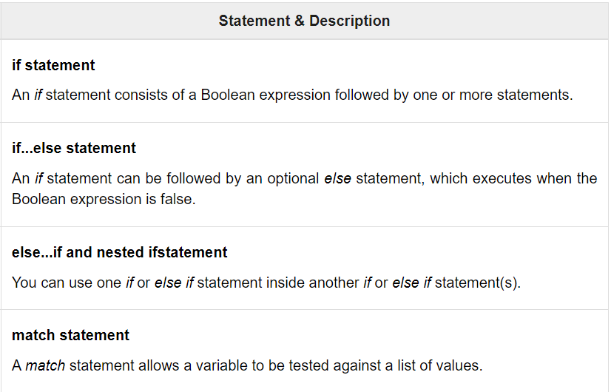
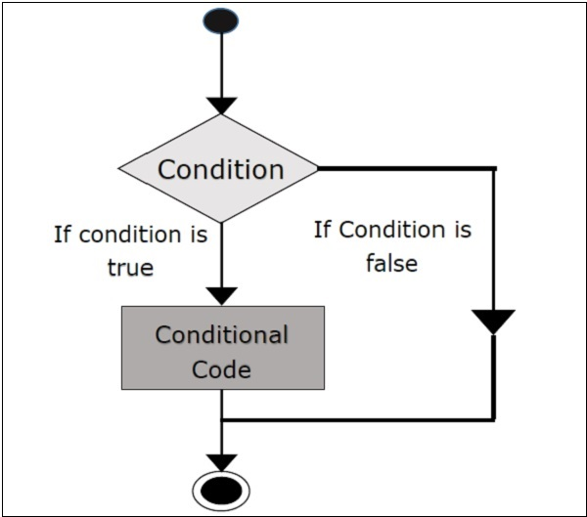
Conditional Statements

Slide 22
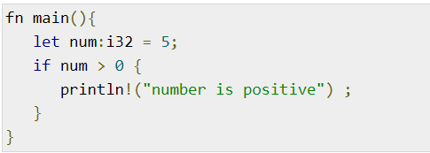
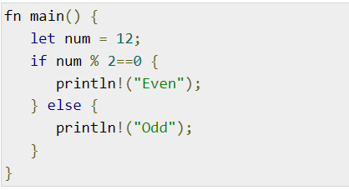
If statement
If /else statement

Slide 23
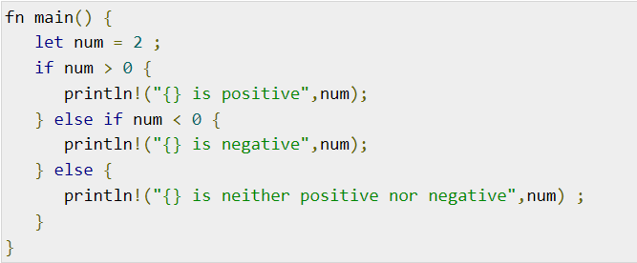
Nested if/else statement

Slide 24
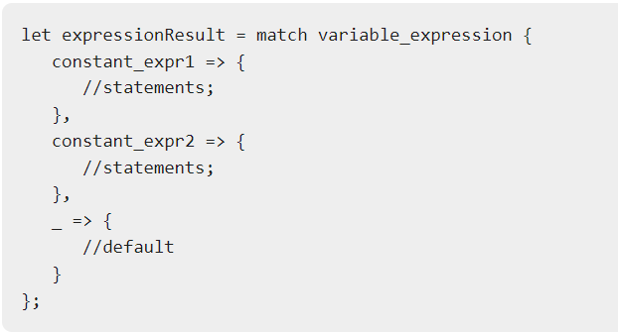
Match Statement
Match statement is working as if statement.
Using match to check if current value is matching in the list is similar to switch case in C language.

Slide 25
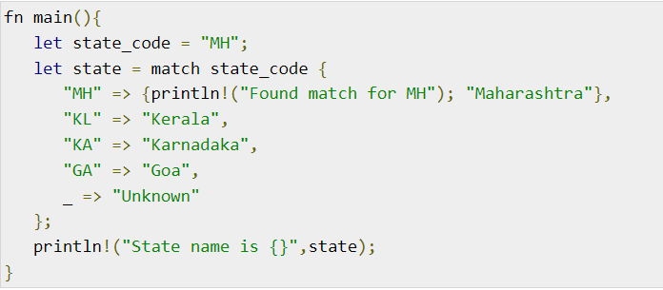

Example
Output:

Slide 26
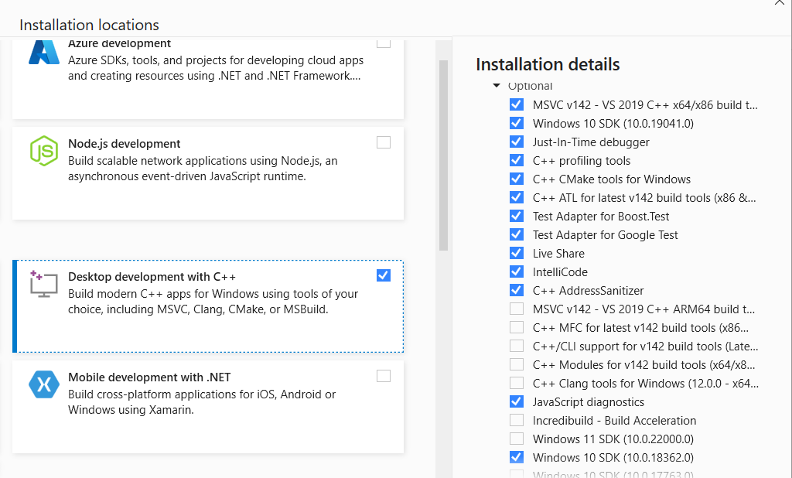
Setup and Install Environment
Window: Download with Win OS https://www.rust-lang.org/tools/install
Others: https://forge.rust-lang.org/infra/other-installation-methods.html
Go to Visual Studio Installer to install
Desktop Development with C++.

Slide 27
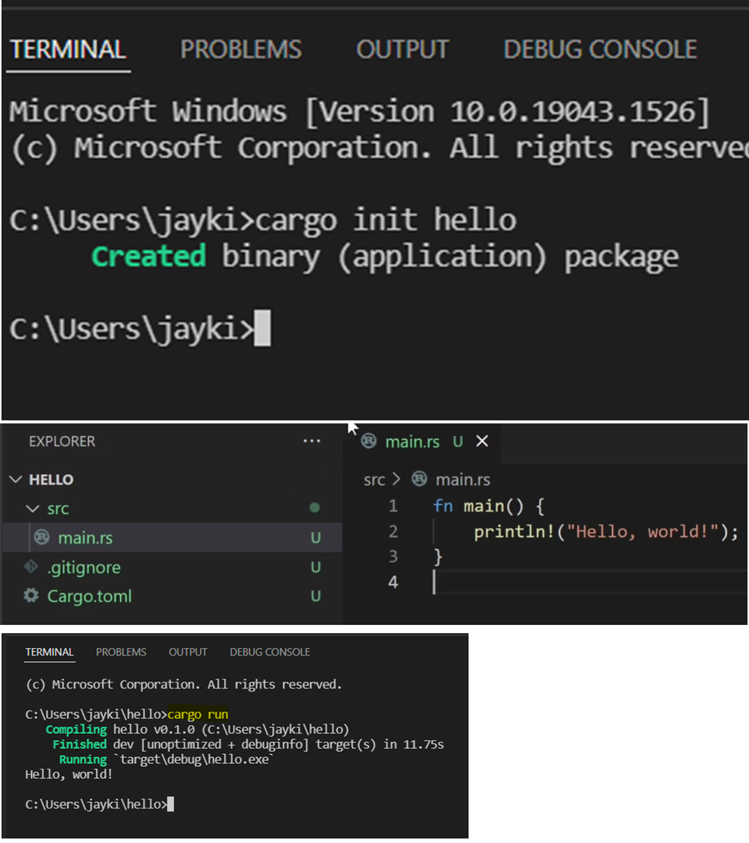
Command Line Terminal (CMD)
Open VS code -> Terminal -> New Terminal -> cargo init hello
=> This will create a binary application.
Open folder -> click on ‘hello’ folder.
There is a main.rs file with some rust code in it.
Use command ‘cargo run’.

Slide 28
References
Rust Tutorial Point
Google Image
Rust Zero To Mastery
RustLang
RustLang playground
Install Rust Engine

